Slide 1
TAK Server - AD/LDAP
You should have a TAK Server fully stood up to proceed.

Slide 2
TAK Serve - LDAP Integration
Update your server:
sudo dnf update -y
Install OpenLDAP Packages:
sudo dnf config-manager --set-enabled plus
sudo dnf install openldap openldap-servers openldap-clients -y
Enable and start the LDAP service:
sudo systemctl enable slapd --now

Slide 3
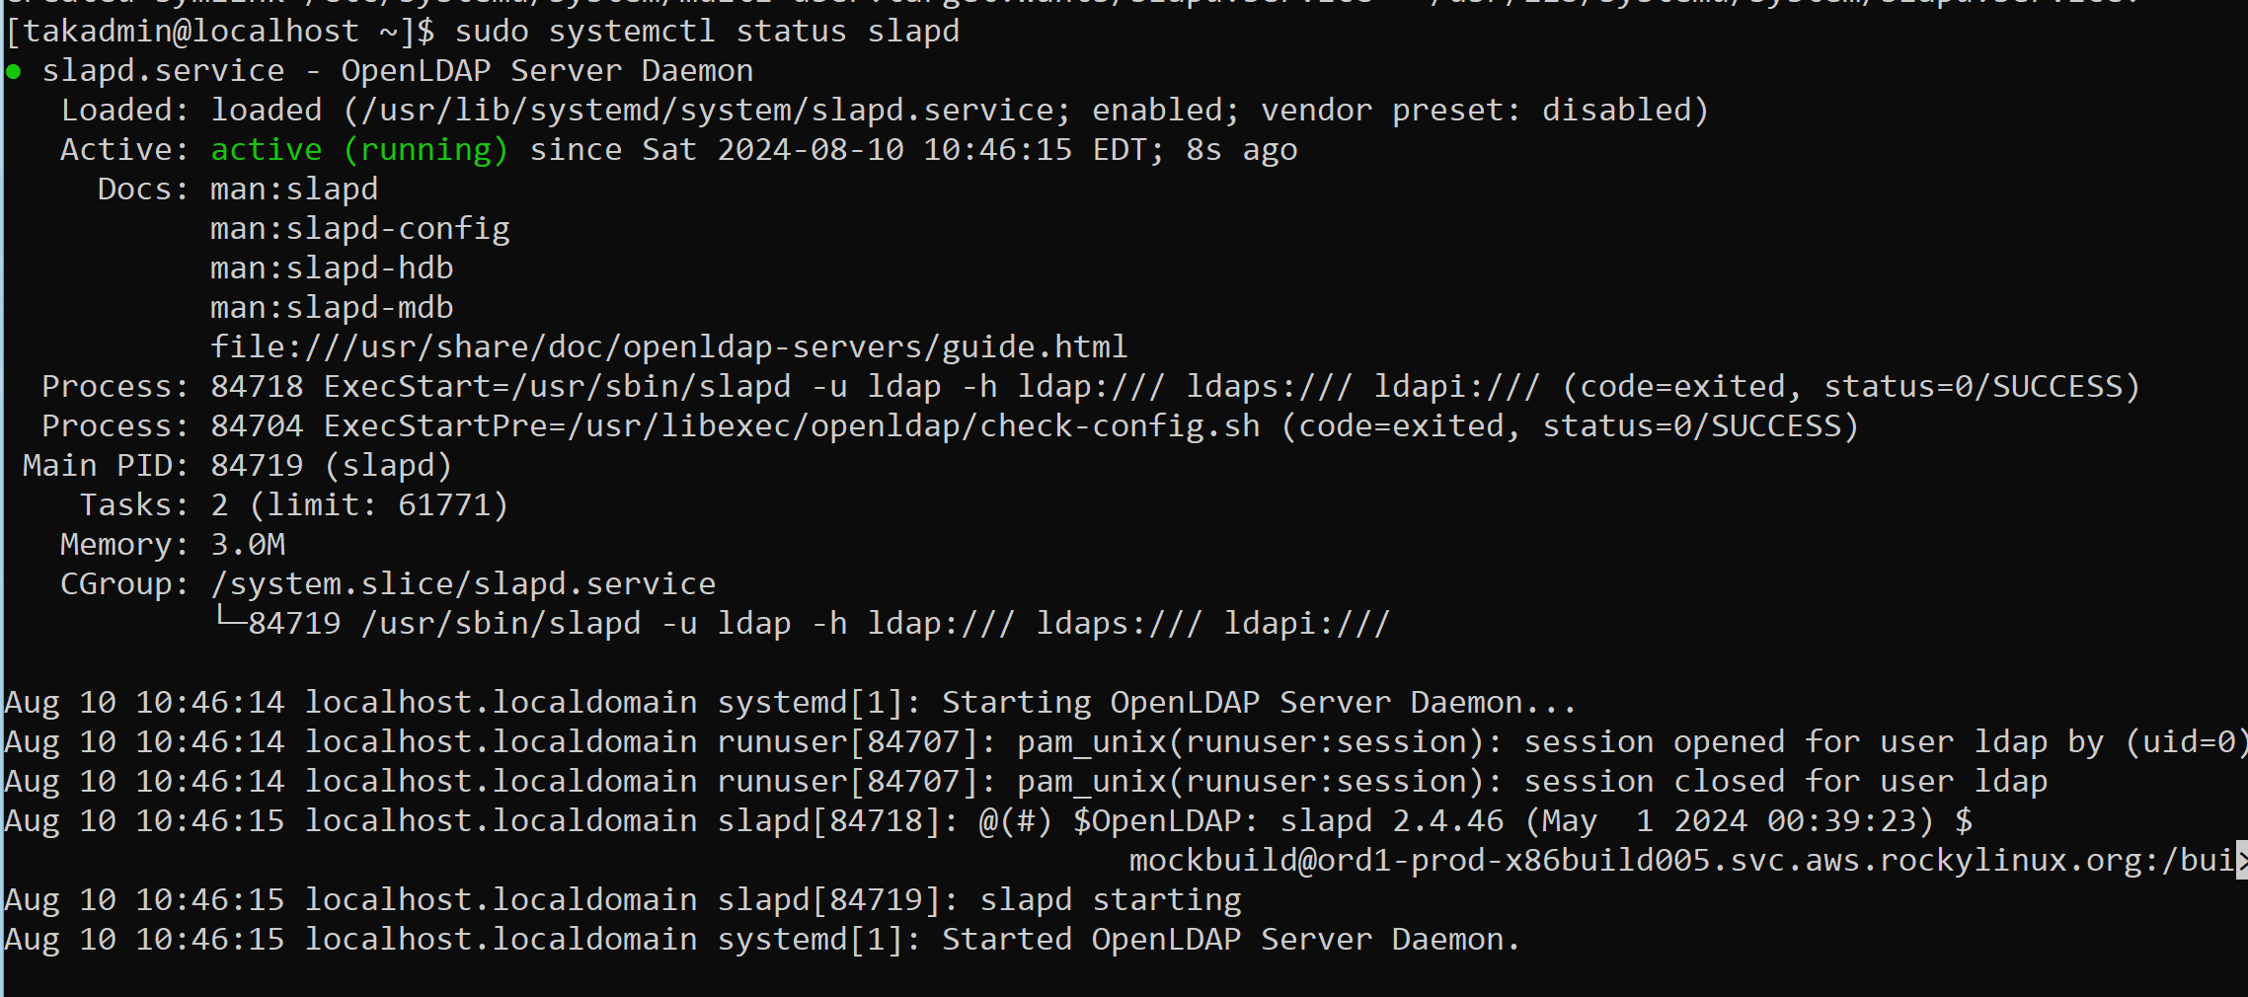
TAK Server - LDAP Integration
Verify the service is running:
sudo systemctl status slapd

Slide 4
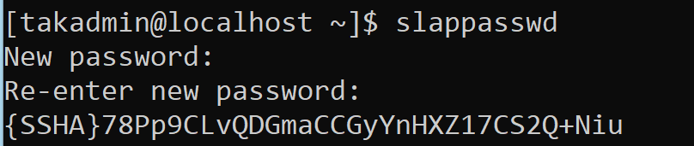
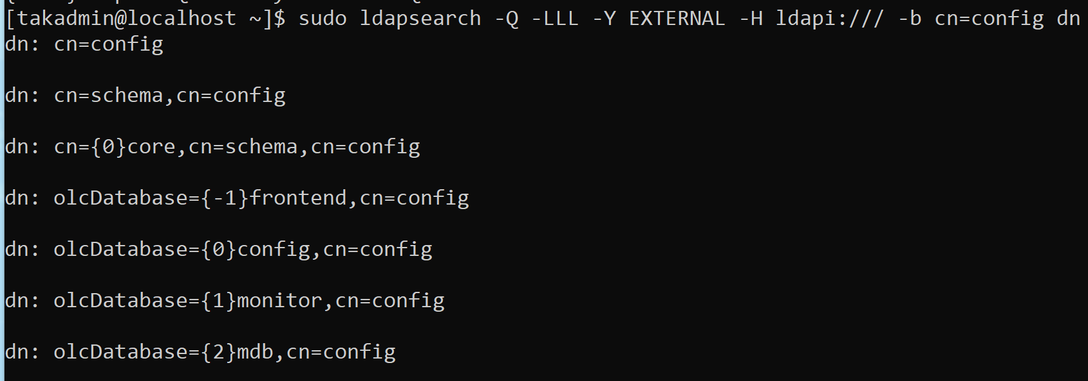
TAK Server - LDAP Integration
Configure OpenLDAP
Generate a hashed password for the LDAP administrator:
slappasswd
Enter in a password of your choice: password
Copy and save the hashed password.
Check the databases backend before modifying:
sudo ldapsearch -Q -LLL -Y EXTERNAL -H ldapi:/// -b cn=config dn
The last entry is the important one we need to note.

Slide 5
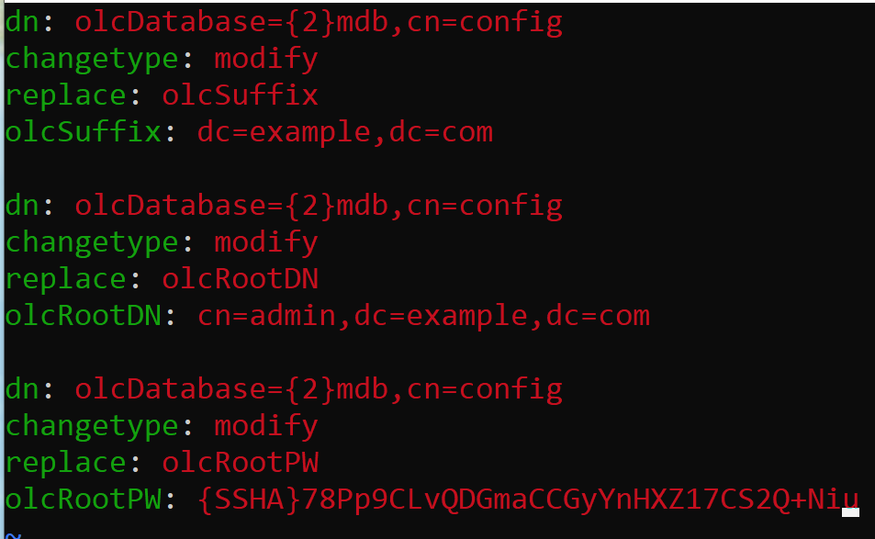
TAK Server - LDAP Integration
Create a LDIF file (“db.ldif”) to configure the domain and admin credentials:
Create the file: vim db.ldif
Add the following to the file:
olcRootPW: add your hashed password
To save and exit:
Press “esc” key
Type: :wq!
Press enter
Apply the configuration:
sudo ldapmodify -Y EXTERNAL -H ldapi:/// -f db.ldif

Slide 6
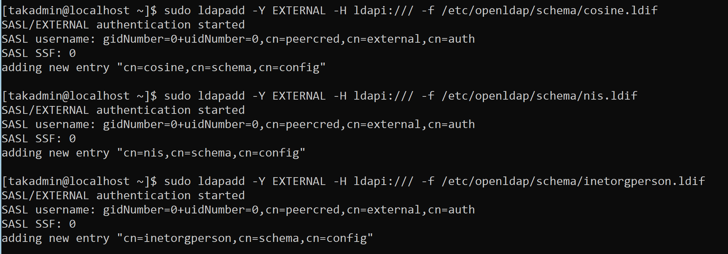
TAK Server - LDAP Integration
Add the necessary schemas to the LDAP directory:
sudo ldapadd -Y EXTERNAL -H ldapi:/// -f /etc/openldap/schema/cosine.ldif
sudo ldapadd -Y EXTERNAL -H ldapi:/// -f /etc/openldap/schema/nis.ldif
sudo ldapadd -Y EXTERNAL -H ldapi:/// -f /etc/openldap/schema/inetorgperson.ldif

Slide 7
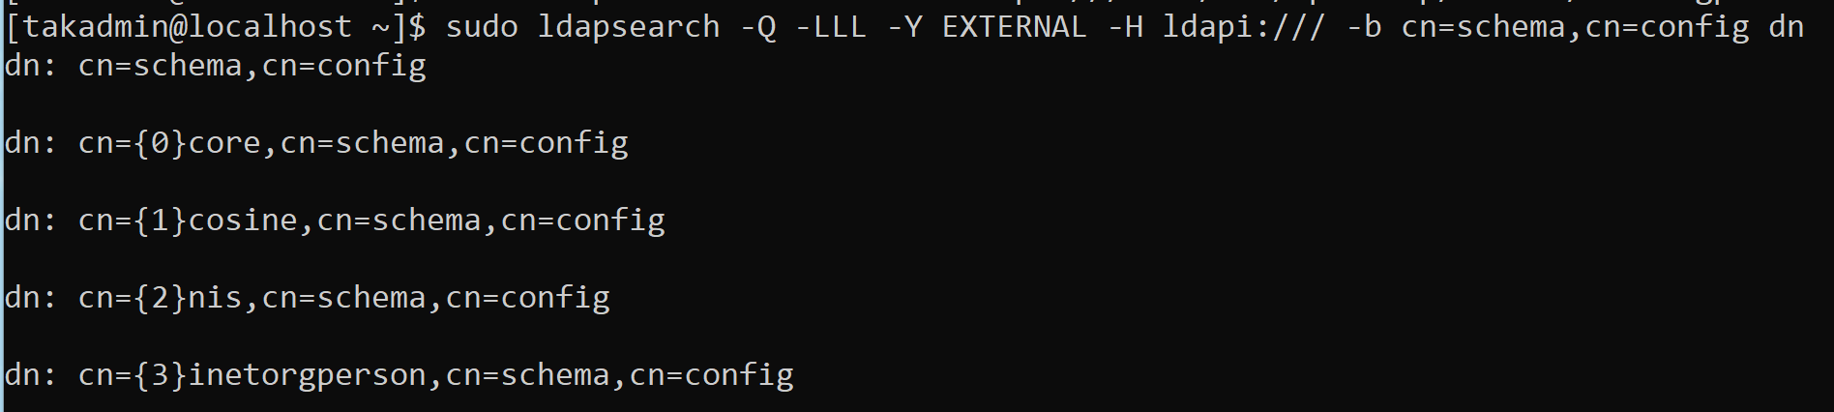
TAK Server - LDAP Integration
To verify is the schemas were applied run the following:
sudo ldapsearch -Q -LLL -Y EXTERNAL -H ldapi:/// -b cn=schema,cn=config dn

Slide 8
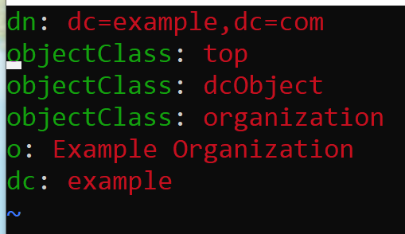
TAK Server - LDAP Integration
To check existing OUs (Organizational Units):
sudo ldapsearch -x -LLL -b dc=example,dc=com “(objectClass=organizationalUnit)” dn
To create a base DN, create a LDIF file (“add-base.ldif”)
vim add-base.ldif
Add the following to the file:
Add the changes:
sudo ldapadd -x -D “cn=admin,dc=example,dc=com” -W -f add-base.ldif

Slide 9
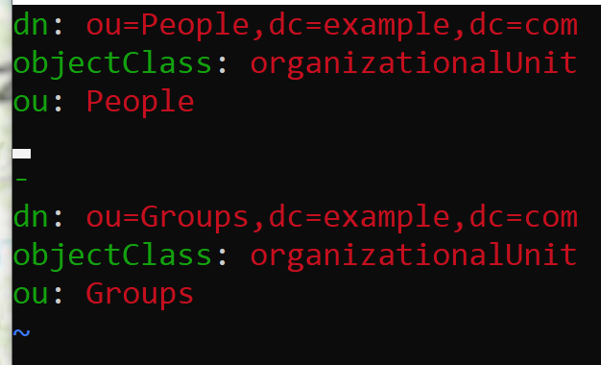
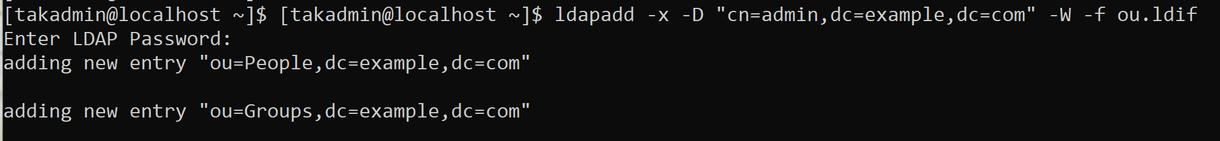
TAK Server - LDAP Integration
To create a Organizational Unit (OU):
Create a LDIF file (“ou.ldif”)
vim ou.ldif
Add the following to the file: →
Apply the configuration:
ldapadd -x -D “cn=admin,dc=example,dc=com” -W -f ou.ldif

Slide 10
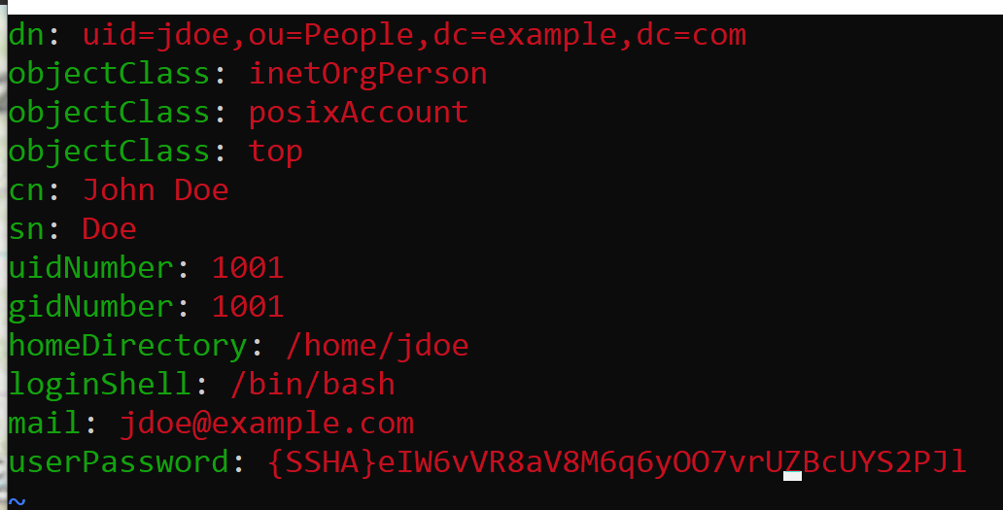
TAK Server - LDAP Integration - Managing Users and Groups
Add a user:
Create a new LDIF file (“new_user.ldif”)
vim new_user.ldif
Add the following to the file: →
Apply the changes:
sudo ldapadd -x -D cn=admin,dc=example,dc=com -W -f new_user.ldif
Verify the changes:
sudo ldapsearch -x -LLL -b dc=example,dc=com “(uid=jdoe)”

Slide 11
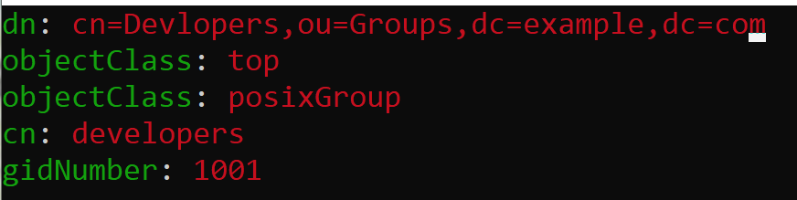
TAK Server - LDAP Integration - Managing Users and Groups
Create a new Group:
Create a new LDIF file (“new_group.ldif”)
vim new_group.ldif
Add the following to the file: →
Apply the changes:
sudo ldapadd -x -D cn=admin,dc=example,dc=com -W -f new_group.ldif
Verify the changes:
sudo ldapsearch -x -LLL -b dc=example,dc=com “(cn=Developers)”

Slide 12
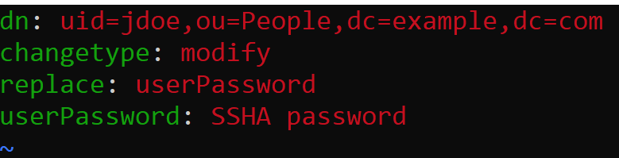
TAK Server - LDAP Integration - Modify Users and Groups
To modify a user:
Create a LDIF file (“modify_user.ldif”)
vim modify_user.ldif
Add the following to the file: →
This example changes the users password.
Apply the changes:
sudo ldapmodify -x -D cn=admin,dc=example,dc=com -W -f modify_user.ldif
Verify the changes;
sudo ldapsearch -x -LLL -b dc=example,dc=com “(uid=jdoe)”

Slide 13
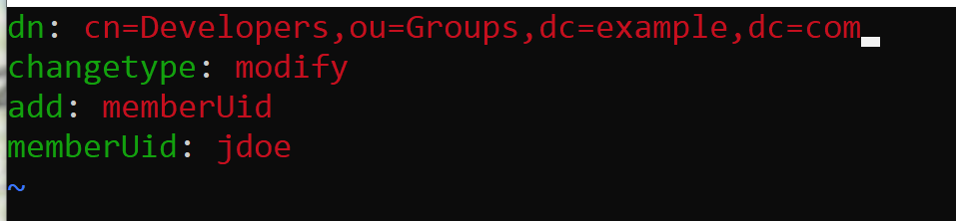
TAK Server - LDAP Integration - Modify Users and Groups
To modify a group:
Create a new LDIF file (“modify_group.ldif)”
vim modify_group.ldif
Add the following to the file: →
This example adds a user to a group.
Apply the changes:
sudo ldapmodify -x -D cn=admin,dc=example,dc=com -W -f modify_group.ldif
Verify the changes:
sudo ldapsearch -x -LLL -b dc=example,dc=com “(cn=Developers)”

Slide 14
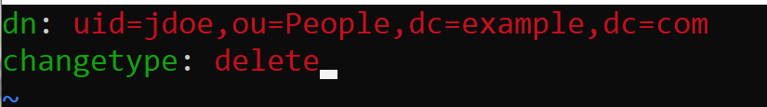
TAK Server - LDAP Integration - Managing Users and Groups
To delete a user:
Create a LDIF file (“delete_user.ldif”)
vim delete_user.ldif
Add the following to the file: →
Apple the changes:
sudo ldapdelete -x -D cn=admin,dc=example,dc=com -W uid=jdoe,ou=People,dc=example,dc=com
Verify the changes:
sudo ldapsearch -x -LLL -b dc=example,dc=com “(uid=jdoe)”
There should be an empty response since the user was deleted.

Slide 15
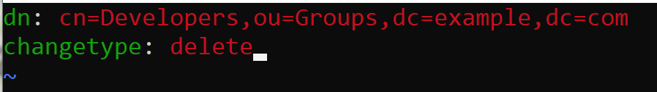
TAK Server - LDAP Integration - Managing Users and Groups
To Delete a group:
Create a new LDIF file (“delete_group.ldif”)
vim delete_group.ldif
Add the following to the file: →
Apply the changes:
sudo ldapdelete -x -D cn=admin,dc=example,dc=com -W cn=Developers,ou=Groups,dc=example,dc=com
Verify the changes:
sudo ldapsearch -x -LLL -b dc=example,dc=com “(cn=Developers)”
You should not get any response since the group was deleted.

Slide 16
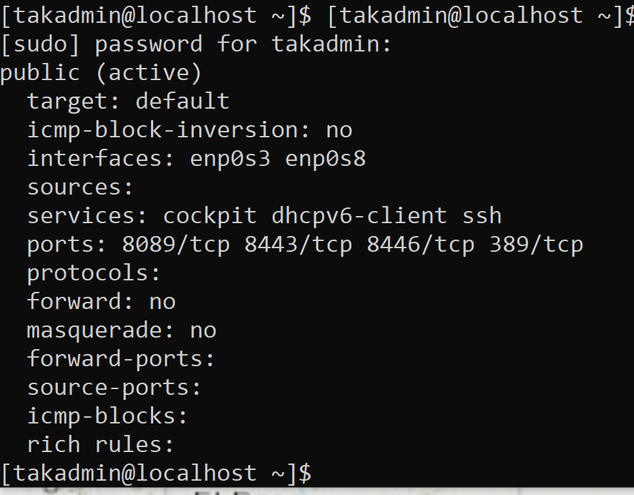
TAK Server -LDAP Integration - Connecting to TAK Server
Verify the default port needed for LDAP is configured:
sudo firewall-cmd --list-all
If port 389/tcp is not enabled do the following:
sudo firewall-cmd --zone=public --add-port 389/tcp --permanent
Reload the firewall:
sudo firewall-cmd --reload
Verify the port was added.
sudo firewall-cmd --list-all

Slide 17
TAK Server -LDAP Integration - Connecting to TAK Server
To configure the TAK Server:
Enter the tak user:
sudo su tak
Open the CoreConfig file with a text editor:
vim /opt/tak/CoreConfig.xml
Add the following:
<auth default="ldap" x509groups="true" x509addAnonymous="false">
<ldap url="ldap://192.168.1.119:389" userstring="uid={username},ou=People,dc=example,dc=com" updateinterval="60" groupNameExtractorRegex="CN=(.*?)(?:,|$)" style="DS" serviceAccountDN="cn=admin,dc=example,dc=com" serviceAccountCredential="password" groupObjectClass="groupOfNames" userObjectClass="inetOrgPerson" groupBaseRDN="dc=example,dc=com" userBaseRDN="ou=People,dc=example,dc=com"/>
</auth>

Slide 18
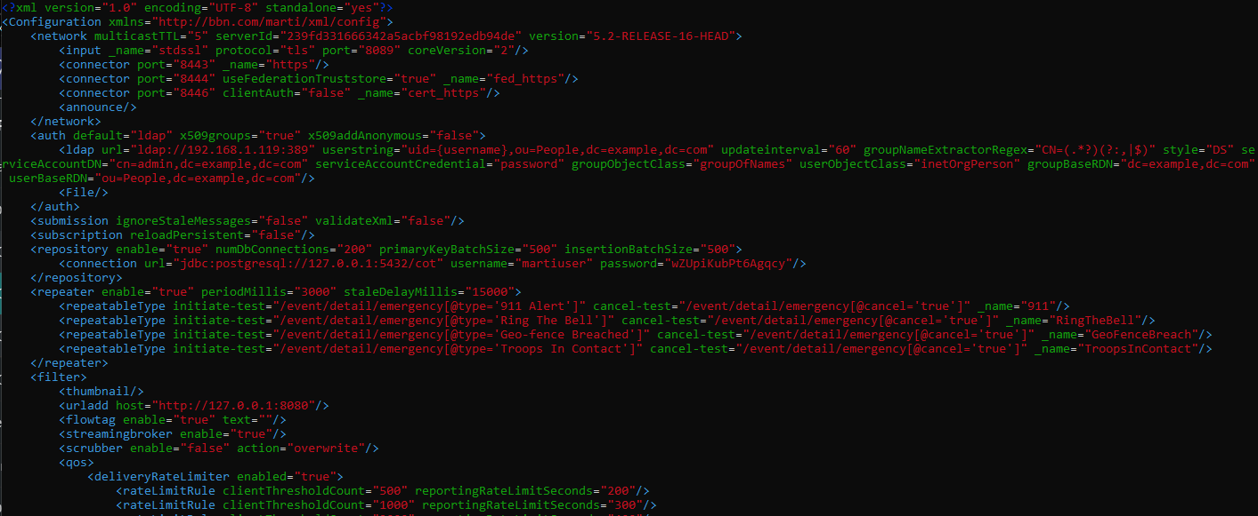
TAK Server -LDAP Integration - Connecting to TAK Server
The additions to the CoreConfig.xml file should look as follows:

Slide 19
TAK Server -LDAP Integration - Connecting to TAK Server
Once the changes have been made restart the TAK Server:
sudo systemctl restart takserver
You can monitor the system to know when the server is back online with:
tail -f /opt/tak/logs/takserver-messaging.log
When the server is back online you can verify the LDAP service is running as expected by trying to logging with the user credentials created through the LDAP service at the following:
https://<IP address>:8446
If you are able to login then you have successfully integrated the LDAP service.

Slide 20
TAK Server -LDAP Query
To query users and groups from your database:
Use yum as it provides commands and options to search for the parent package:
sudo yum whatprovides ldapsearch
Install the openldap-clients
sudo yum install openldap-clients -y
Search for the syntax information:
ldapsearch -LLL -H ldap://19.168.1.119:389 -b ‘dc=example,dc=com’ -x -D ‘example/tak.service’ -W ‘(sAMAccountName=<user>)’

Slide 21
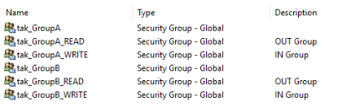
TAK Server - LDAP Group Prefix
IN and OUT Groups with LDAP:
To apply the in/out filters to a group with LDAP you need to create an additional group with the same naming but with either “_READ” or “_WRITE” at the end of the name.
_READ: out group
_WRITE: in group
If you somehow forget to add a user to a group, they will default to the __ANON__ group when they authenticate to the TAK Server.

Slide 22
Resources
https://www.golinuxcloud.com/install-configure-openldap-rocky-linux-8/

Slide 23
TAK Server - Ports
Use the following to print the PID on a specific port:
fuser 8080/tcp
fuser 8080/udp
Use the following to kill a process on a port:
fuser -k 8080/tcp
fuser -k 8080/udp
https://docs.redhat.com/en/documentation/red_hat_directory_server/12/html/installing_red_hat_directory_server/changing-the-ldap-and-ldaps-port-numbers_installing-rhds#changing-the-port-numbers-using-the-command-line_changing-the-ldap-and-ldaps-port-numbers

